Slide 1
Feedback Control Systems (FCS)
Lecture19-20
Routh-Herwitz Stability Criterion
Dr. Imtiaz Hussain
email: imtiaz.hussain@faculty.muet.edu.pk
URL :http://imtiazhussainkalwar.weebly.com/

Slide 2
Stability of Higher Order Systems
Un-Stable
Stable

Slide 3
Routh-Hurwitz Stability Criterion
It is a method for determining continuous system stability.
The Routh-Hurwitz criterion states that “the number of roots of the characteristic equation with positive real parts is equal to the number of changes in sign of the first column of the Routh array”.

Slide 4
Routh-Hurwitz Stability Criterion
This method yields stability information without the need to solve for the closed-loop system poles.
Using this method, we can tell how many closed-loop system poles are in the left half-plane, in the right half-plane, and on the jw-axis. (Notice that we say how many, not where.)
The method requires two steps:
Generate a data table called a Routh table.
interpret the Routh table to tell how many closed-loop system poles are in the LHP, the RHP, and on the jw-axis.

Slide 5
Routh’s Stability Condition
If the closed-loop transfer function has all poles in the left half of the s-plane, the system is stable. Thus, a system is stable if there are no sign changes in the first column of the Routh table.
The Routh-Hurwitz criterion declares that the number of roots of the polynomial that are lies in the right half-plane is equal to the number of sign changes in the first column. Hence the system is unstable if the poles lies on the right hand side of the s-plane.

Slide 6
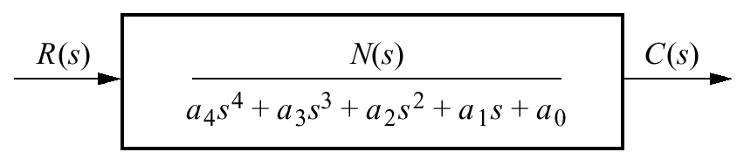
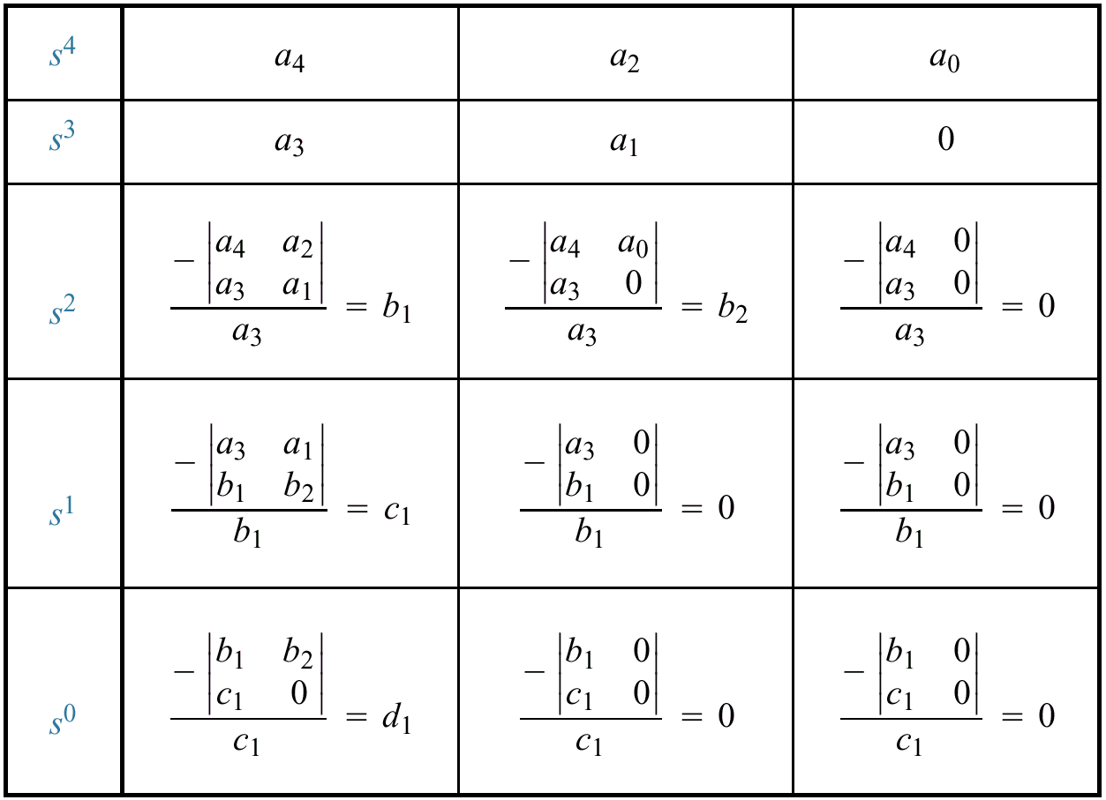
Generating a basic Routh Table
Only the first 2 rows of the array are obtained from the characteristic eq. the remaining are calculated as follows;

Slide 7

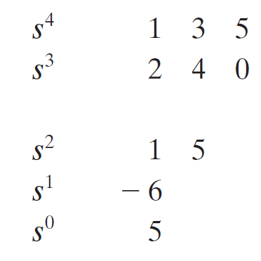
Example#1
Consider the following characteristics equation:
Develop Routh array and determine the stability of the system.

Slide 8
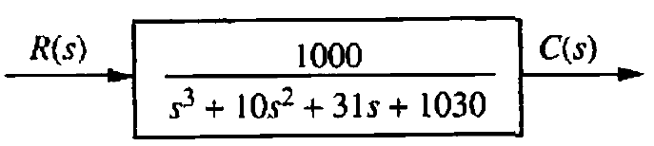
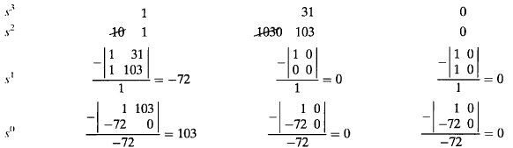
Example#2
Consider the following system:
Develop Routh array and determine the stability of the system.

Slide 9
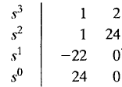
Example#3
Find the stability of the continues system having the characteristic polynomial of a third order system is given below
The Routh array is
Because TWO changes in sign appear in the first column, we find that two roots of the characteristic equation lie in the right hand side of the s-plane. Hence the system is unstable.

Slide 10
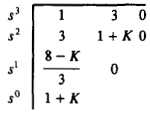
Example#4
Determine a rang of values of a system parameter K for which the system is stable.
The Routh table of the given system is computed and shown is the table below;
For system stability, it is necessary that the conditions 8 – k >0, and 1 + k > 0, must be satisfied. Hence the rang of values of a system parameter k must lie between -1 and 8 (i.e., -1 < k < 8).

Slide 11
Special Cases
Case-1: Zero in the first column
If first element of a row is zero, division by zero would be required to form the next row.
To avoid this phenomenon, zero is replaced by a very small number (say є).

Slide 12

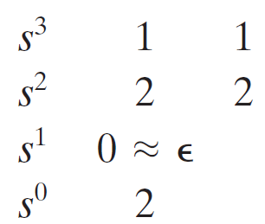
Example#5

Slide 13
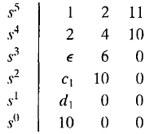

Example#5
Determine the stability of the system having a characteristic equation given below;
The Routh array is shown in the table;
Where
There are TWO sign changes due to the large negative number in the first column,
Therefore the system is unstable, and two roots of the equation lie in the right half of the s-plane.

Slide 14
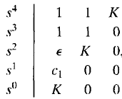

Determine the range of parameter K for which the system is unstable.
Example#6
The Routh array of the above characteristic equation is shown below;
Where
Therefore, for any value of K greater than zero, the system is unstable.
Also, because the last term in the first column is equal to K, a negative value of K will result in an unstable system.
Consequently, the system is unstable for all values of gain K.

Slide 15
Case-I: Stability via Reverse Coefficients (Phillips, 1991).
A polynomial that has the reciprocal roots of the original polynomial has its roots distributed the same—right half-plane, left half plane, or imaginary axis—because taking the reciprocal of the root value does not move it to another region.
If we can find the polynomial that has the reciprocal roots of the original, it is possible that the Routh table for the new polynomial will not have a zero in the first column.
The polynomial with reciprocal roots is a polynomial with the coefficients written in reverse order.
This method is usually computationally easier than the epsilon method.

Slide 16

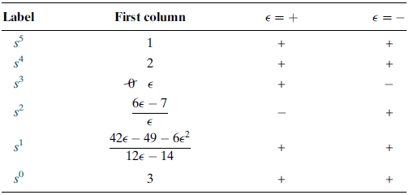
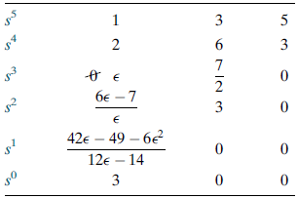
Determine the stability of the of the closed-loop transfer function;
Table-1: The complete Routh table is formed by using the denominator of the characteristic equation T(s).
Table-2: shows the first column of Table-1 along with the resulting signs for choices of ε positive and ε negative.
A zero appears only in the first column (the s3 row).
Next replace the zero by a small number, ε, and complete the table.
Assume a sign, positive or negative, for the quantity ε.
When quantity ε is either positive or negative, in both cases the sign in the first column of Routh table is changes twice.
Hence, the system is unstable and has two poles in the right half-plane.

Slide 17

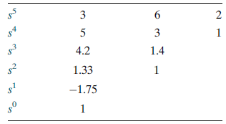
Example-7: Determine the stability of the closed-loop transfer function;
First write a polynomial that has the reciprocal roots of the denominator of T(s).
This polynomial is formed by writing the denominator of T(s) in reverse order. Hence,
The Routh table is
Since there are TWO sign changes, the system is unstable and has TWO right-half-plane poles.
This is the same as the result obtained in the previous Example.
Notice that Table does not have a zero in the first column.

Slide 18
Case-II: Entire Row is Zero.
Sometimes while making a Routh table, we find that an entire row consists of zeros.
This happen because there is an even polynomial that is a factor of the original polynomial.
This case must be handled differently from the case of a zero in only the first column of a row.

Slide 19
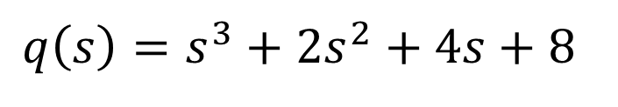
Case-II: Entire Row is Zero.
The characteristic equation q(s) of the system is
$$q\left(s\right)=s^{3}+2s^{2}+4s+8$$

Slide 20

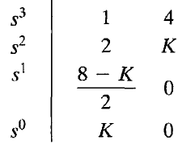

Example-8: Determine the stability of the system.
The characteristic equation q(s) of the system is
Where K is an adjustable loop gain.
The Routh array is then;
For a stable system, the value of K must be;

Slide 21
Example-8: Determine the stability of the system.
Also, when K = 8, we obtain a row of zeros (Case-II).
The auxiliary polynomial, U(s), is the equation of the row preceding the row of Zeros.
The U(s) in this case, obtained from the s² row.
The order of the auxiliary polynomial is always even and indicates the number of symmetrical root pairs.

Slide 22




Example-8: Determine the stability of the system.
The auxiliary polynomial, U(s), can be obtain as;

Slide 23

Example#9
Consider the following characteristic equation. Determine the range of K for stability.

Slide 24
End of Lectures-19-20
To download this lecture visit
http://imtiazhussainkalwar.weebly.com/

